Slide 1

Web Community Manager
Accessibility Online Training
Today’s Trainer: Hannah Kloscak

Slide 2
Disclaimer
The information in this presentation was prepared for informational purposes only. The information contained herein is not intended to constitute legal advice and you should consult with your own attorney when developing your online accessibility program and policy. Blackboard assumes no liability in connection to this presentation and any information contained herein.

Slide 3
Learning Outcomes
At the end of today’s hands-on workshop you will be able to:
Define accessibility and its importance.
Understand common accessibility issues.
Format text with headings.
Create accessible links and images.
Understand how and when to use tables and lists.
Understand the principles of accessible documents.
Understand the importance and impact of color.
Understand the different video caption types.
Find helpful materials for compliance and accessibility errors.

Slide 4
Websites Used During The Training
Your Website
  Sign In
  Open Up Site Manager
  Find a Section Workspace to Work In
Notes:
THE BIT.LY URL IS CASE SENSITIVE (and it leads to the training site's homepage)

Slide 5
What is Accessibility?
Accessibility is a word to describe whether or not something can be accessed by people with all abilities and disabilities.
The goal of accessibility is creating equal access for all.

Slide 6
Examples of Accessibility
Ramps to building entrances.
Sign language interpreters.
Captioning on television shows
Black and white text on websites.
Testing accommodations for students.
Notes:
Testing example?

Slide 7
Accessibility on the Web
Web accessibility refers to the inclusive practice of removing barriers that prevent interaction with, or access to, websites by people with disabilities.
When sites are correctly designed, developed and edited, all users have equal access to information and functionality.

Slide 8
Accessibility Standards
Authored and implemented by the U.S. Office of Civil Rights.
Evaluated using international standards known as Web Content Accessibility Guidelines (WCAG).

Slide 9
Blackboard & Accessibility
Blackboard’s accessibility program is built on the following core beliefs:
Accessibility is an imperative, not an afterthought.
Understand, empathize, and act.
Deliver the promise of educational technology.
Notes:
Accessibility is an imperative, not an afterthought.- the goal for web content creators should be to adopt accessibility measures as part of your workflow when adding content on the site
Understand, empathize, and act.- While we all likely recognize the importance of equal opportunity, we must act on this. It is not enough to talk the talk, we must walk the walk as well.
Deliver the promise of educational technology.- We recognize the promise that technology has to offer people with disabilities and we strive to take advantage of that promise to benefit all stakeholders

Slide 10
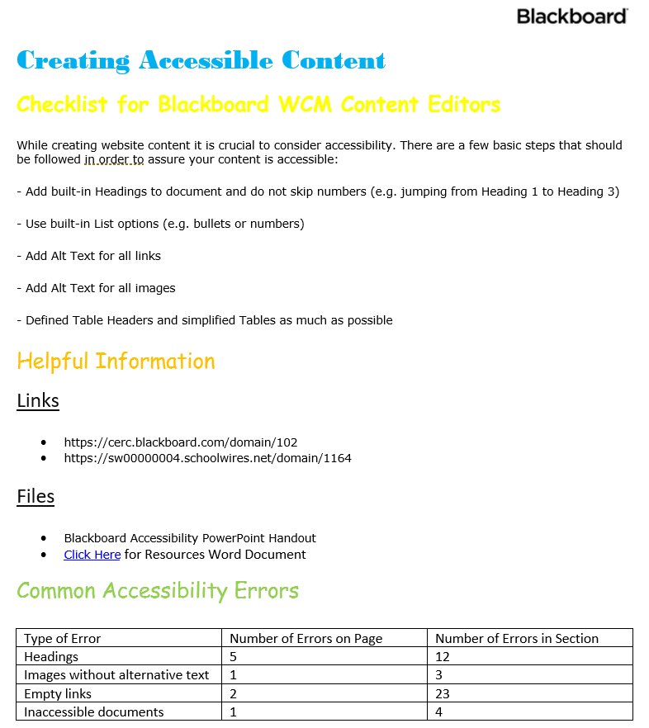

Screen Reader Activity Part 1:
Content Created without Accessibility in Mind
Notes:
Prompt attendees to look at the document as the screen-reader reads to them and note what content was skipped over or unaccounted for due to the content on this page being created without accessibility in mind.

Slide 11
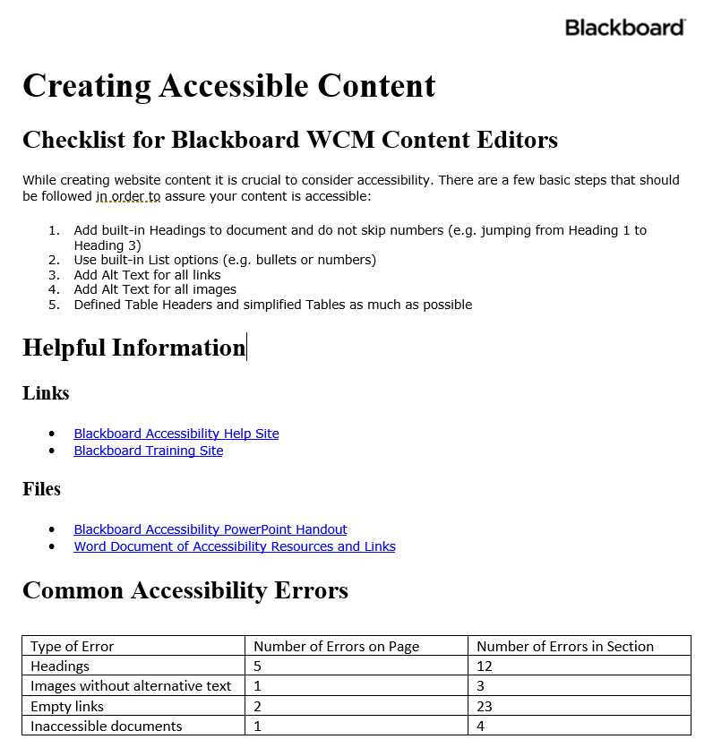
Screen Reader Activity Part 2:
Content Created with Accessibility in Mind
Notes:
Now tell attendees to notice how much more clear and understandable the composition is when the screenreader reads from an accessibly created document

Slide 12
Diverse Accessibility Challenges
Cognitive
Visual
ADHD
Dyslexia
Down Syndrome
Difficulty concentrating
Difficulty reasoning and understanding
Poor comprehension
Low/poor vision
Color blindness
Total blindness
Difficulty seeing contrasts
Seizure sensitivity
Physical
Hearing
Lost Limbs
Poor gross/fine motor controls such as Muscular Dystrophy
Difficulty communicating struggles
Partial/full paralysis
Limited Hearing
Complete deafness
Difficulty taking notes & reading captions at same time
Notes:
These are the 4 challenge areas that are considered under WCAG 2.0

Slide 13
Common Accessibility Issues:
Improper use of headers.
Empty links or links without alternative text.
Color contrast issues.
Using tables incorrectly.
Missing alternative text tags in images.
Documents that are not built accessibly.
Videos without captions.
Readability level of content.

Slide 14
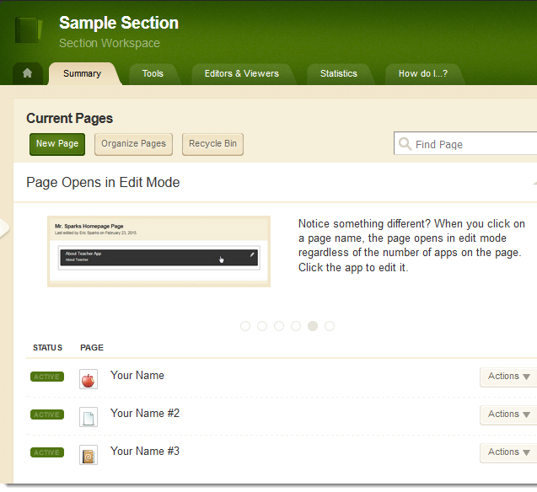
Activity: Build A New Page
Sign in to website
Open Site Manager
Navigate on back end of site to a Section Workspace (Green Title Bar)
Build a Blank Page named “Accessibility Practice” (Hit Save and Exit)
Set “Viewers” to self.

Slide 15
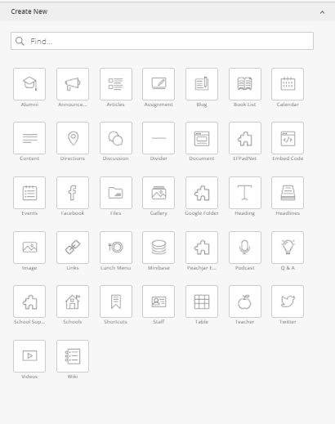
Activity: Add Apps to Page
Add Apps to Page
  Content App
  Shortcuts App
  Image App

Slide 16
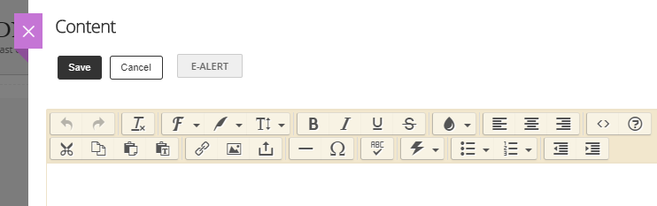
Activity: Content App: Paste As Plain Text
Copy text from training website on Text for Accessibility Training Page.
  bit.ly/wcmtraining
Paste into content app using paste as plain text tool and keyboard shortcuts.

Slide 17
Remove Old Formatting from Text
Use the paste as plain text button (clipboard with T) when adding copied text into the content app.
Use the remove formatting button (Tx) to remove formatting from text already in content app.

Slide 18
Headings
Break up content in longer documents, making content easier to digest
Allows screen reader to jump around within the text.
Provides additional benefits of consistency & automatically populates the site table of contents.
Guidelines for Heading Structure:
  Use a logical and consistent heading structure.
  Use built-in heading styles.
  Don’t use bold, italic, underline, color or font size/style to emulate headings.

Slide 19
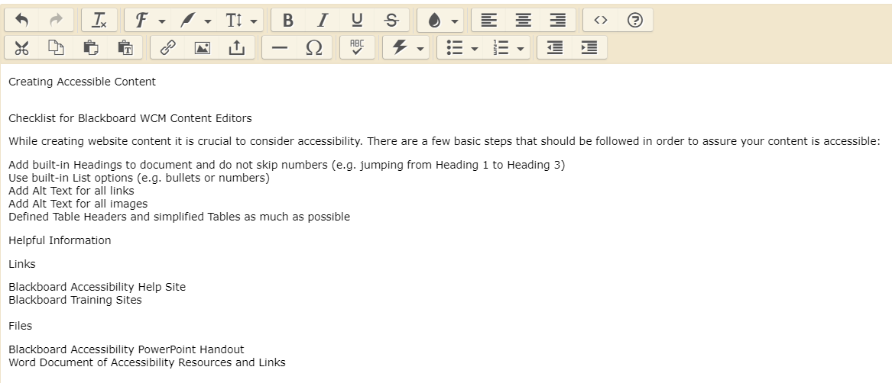
Activity: Content App: Format Text with Headings
1. Correct spacing between lines of text.
2. Use the dropdown menu next to the T button in the content app to format the text with logical headings.
3. Turning on “app names” in App Options will comply as a Heading Level 1.
H1
H2
H2
H3
H3
Notes:
1.) Correct spacing between lines of text- remember to tell attendees that there must be BLANK lines both above and below headings and other content

Slide 20
Additional Text Formatting For Emphasis (Body Text)
Do not rely on color, bold, italics, underline and strikethrough for emphasis. Screen readers do not read this differently; this is only a visual cue.
Use varied punctuation for emphasis. Screen readers change their intonation based upon punctuation.
Use lists to emphasize text. Only lists created using built-in list tools are recognized by screen readers.

Slide 21
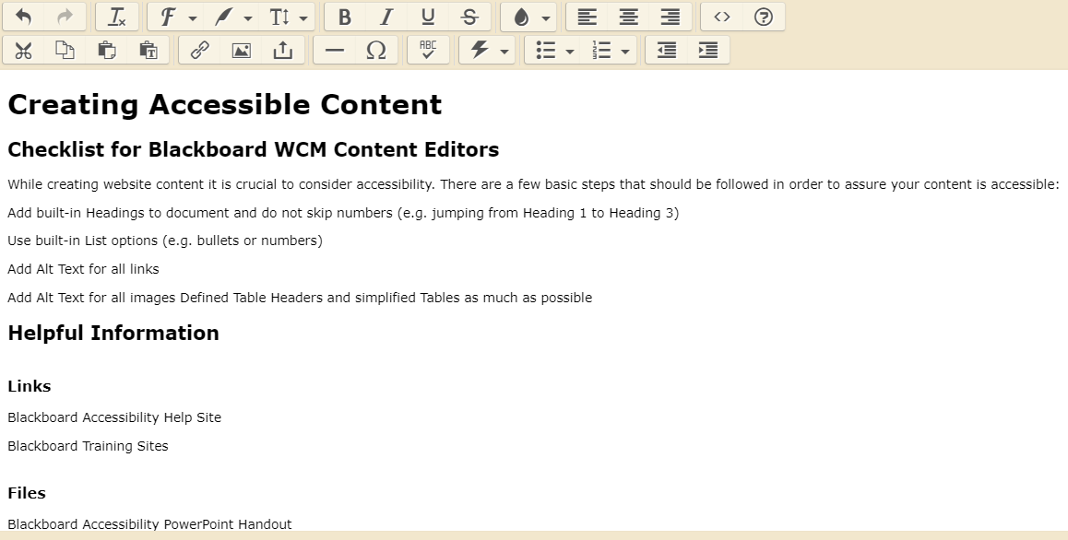
Activity: Content App: Other Formatting
Use the numbered and bulleted list tools to format the text.

Slide 22
Links
Links should be in the form of clickable descriptive text.
  Do not list a URL out in plain text.
  Links cannot simply say “click here”.
Making the clickable text on links longer makes them easier to access by people who may have mobility issues.
All links should have alt text that describes:
  the target (specifically if it opens in a new window).
  context about the link (description of linked content beyond link text / URL).

Slide 23
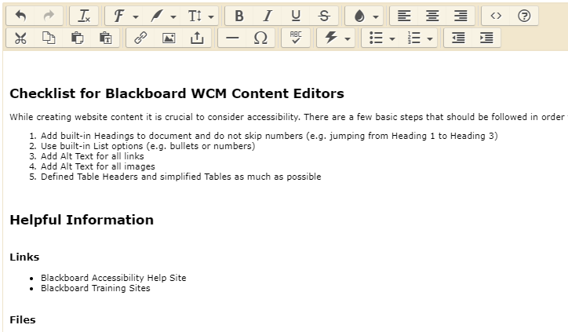
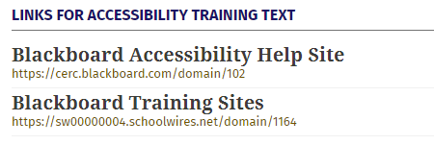
Activity: Content App: Link Formatting
Add links using insert link button.
To get link URLs use link library list on the bottom of the sample text page.

Slide 24
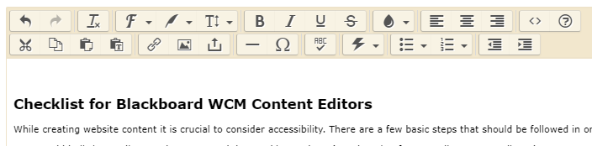
Files
Only upload files that have been built accessibly.
Files must have descriptive clickable text (not “click here”).
All files should have alt text that describes:
  the target (specifically if it opens in a new window).
  context about the file (description of linked content beyond the file name.)

Slide 25
Alternative Text with Images
Allows screen readers to convert the image into words.
Indexes images for searching.
Guidelines for Alternative Text:
  Text should be clear, concise, and descriptive.
  Do not use the same text for every image.
  No unrelated images.
  Avoid decorative text in images.
  Alt text in image must be written out as alternative text.
  If the image is an infographic you should
    Write a narrative telling the same story users get from the visual.
    Provide a link to view the text alternative.
Notes:
-unrelated images can confuse the person listening to the screenreader

Slide 26
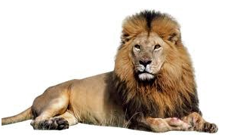
Examples of Alt. Text
Alternative Text = Cat
☒
Alternative Text = Male Lion
☑

Slide 27
Activity: Content App: Image Formatting
Place your cursor where you want the image to go.
Select the insert image button.
Open the clipart library and find a related image.
Add descriptive alternative text and finish adding image.
Notes:
Clipart search term- computer

Slide 28
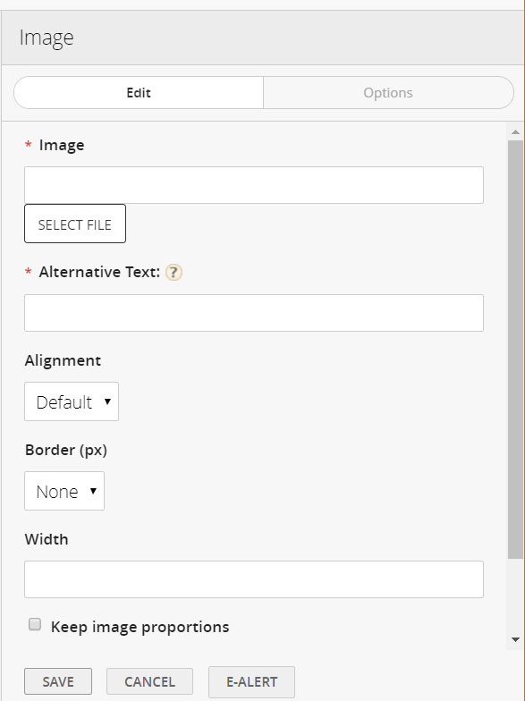
Image App
You can also add an image to the page using an image app.
When using an image app you still must add alternative text.

Slide 29
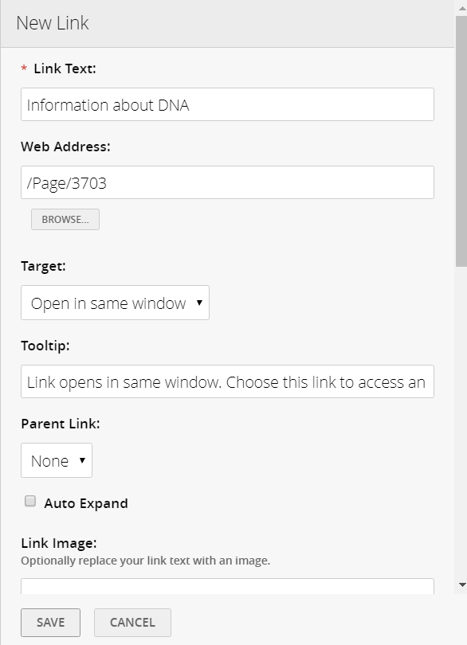
Site Shortcuts App
You can also create a list of links using the site shortcuts app.
The clickable text for each link is called: Link Text.
The alternative text is called: Tooltip.
Turn on the app name to give this app an accessible heading.
Notes:
Explain that alternative text is reffered to as several different terms throughout the site. The "guide" for this is within the resources section of the accessibility channel on the Nittanyville training site

Slide 30
Tables
  Tables should only be used to present tabular data, not for formatting purposes.
  Use the table app to add tables to your website.
    The table app allows your table to be responsive on all devices.
    To make the table app Accessible:
      Check boxes to identify header rows and columns.
      Add “Table Caption” to give brief description of table. (Shows above table).
      Add “Table Summary” to describe relationships between data in detail. (Does Not Show).
An example of an accessibly built table in the table app can be found on the training site.
Notes:
Show table example on backend and userend

Slide 31




F0rmatting Accessible Documents
Structure & Formatting
(Headings, Lists etc.)
Proper Use
Of Tables
Alt Text for
Images & Links
Check With Built-in
Accessibility Tools
*Read full article about Formatting Accessible Documents on Blackboard Help

Slide 32


Building Accessible PDFs
Start from a well formatted source file.
Include accessibility tags when saved to PDF.
PDFs are the best format for website documents.
*Read full article about Formatting Accessible Documents (look for PDF section) on Blackboard Help

Slide 33



Principles of PowerPoint Accessibility
Reading Order
(Check In Outline View)
Slide Titles
Alt Text for
Images & Links
Self-Describing
Clickable Links
*Read full article about the Principles of PowerPoint Accessibility on Blackboard Help

Slide 34
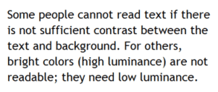
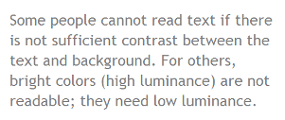
Color Contrast
Low contrast between text and its background can make content difficult to read.
Check the contrast between your text and background colors for WCAG compliance using color contrast analyzers.

Slide 35




Captioning Videos
Create a Storyboard
To Make Self
Captioning Easier
Find Already
Captioned Videos
Edit Automatic
Captions Before
Posting to Website
Upload Videos
To YouTube

Slide 36
Accessibility Checklist 1/2
Use a built in heading structure.
Use the built in list tools.
Add links and files using descriptive clickable text and alternative text.
Add descriptive alternative text to images.
Only use tables for tabular data not display structure.

Slide 37
Accessibility Checklist 2/2
Mark heading rows on tables.
All documents you upload, link or display on your website should accessible.
Embedded videos must include captioning.
Check reading level of content.
Check for high color contrast.

Slide 38
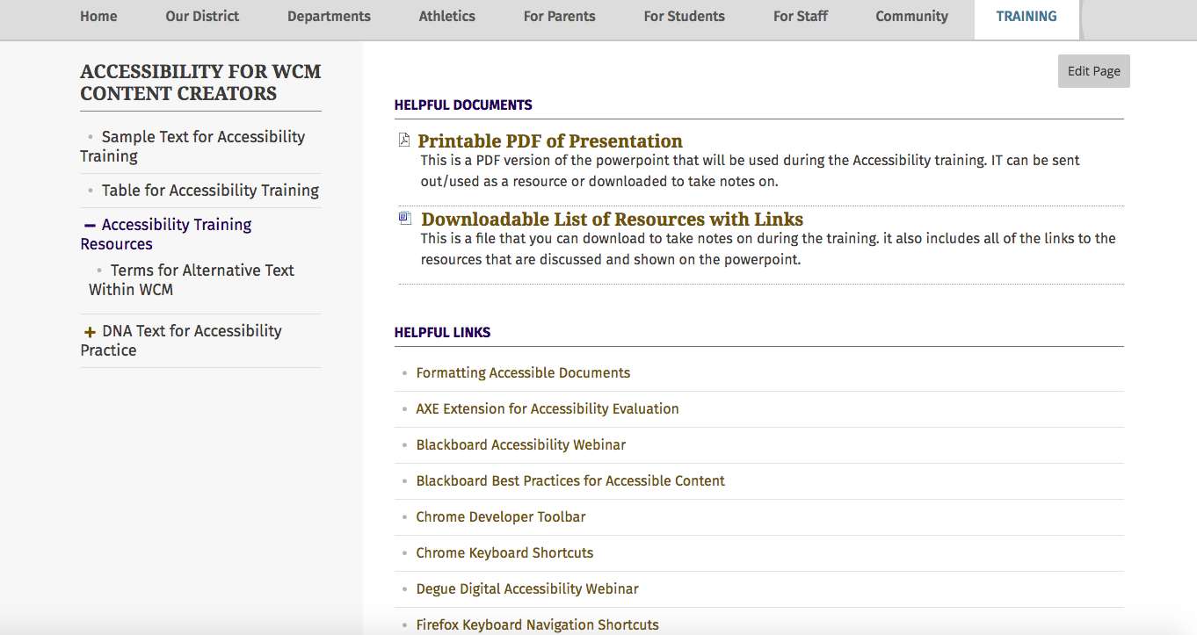
Accessibility Resources
Training Website: bit.ly/wcmtraining
Notes:
Need to still do these

Slide 39
In today’s workshop our focus was to help you:
Define accessibility and its importance.
Understand common accessibility issues.
Format text with headings.
Create accessible links and images.
Understand how and when to use tables and lists.
Understand the principals of accessible documents.
Understand the importance and impact of color.
Understand the different video caption types.
Find helpful materials for compliance and accessibility errors.

